Slide 1


Hospital Management System
Owafa Tashmeem Rafa
1909011

Slide 2

INTRODUCTION
A Hospital Management System (HMS) is a pivotal technological solution that streamlines healthcare administration by digitizing processes such as patient registration and appointment scheduling, minimizing paperwork, and enhancing communication among different departments. Its role in ensuring efficiency and accuracy makes it a fundamental component of modern healthcare delivery.

Slide 3

TABLES
Patients
Doctors
Appointment
Staff
Department
Room
Billing

Slide 4
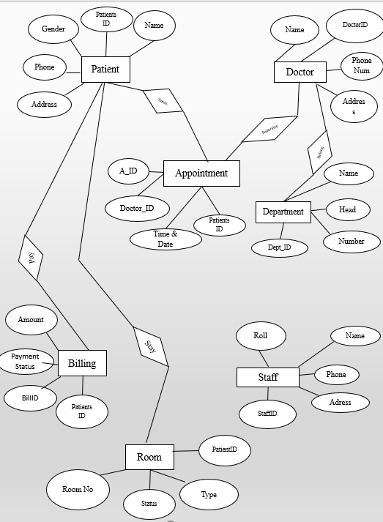
ER DIAGRAM

Slide 5
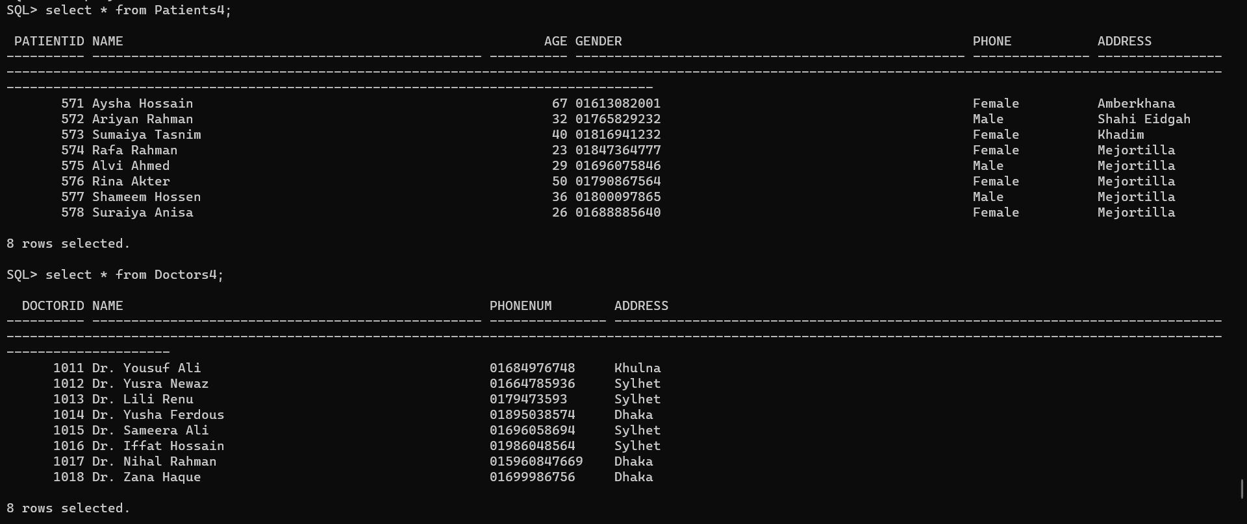
Two tables have been shown below:
--display tables
select * from Patients4;
select * from Doctors4;

Slide 6
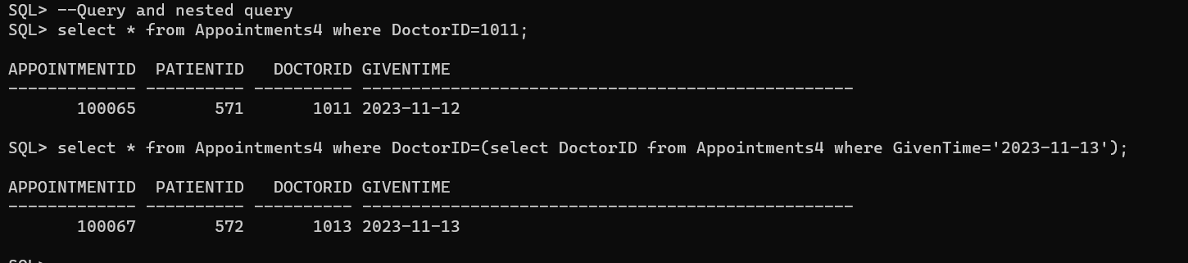
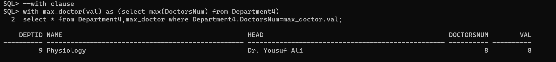
Some operations:
--Query and nested query
select * from Appointments4 where DoctorID=1011;
select * from Appointments4 where DoctorID=(select DoctorID from Appointments4 where GivenTime='2023-11-13');
--with clause
with max_doctor(val) as (select max(DoctorsNum) from Department4)
select * from Department4,max_doctor where Department4.DoctorsNum=max_doctor.val;

Slide 7
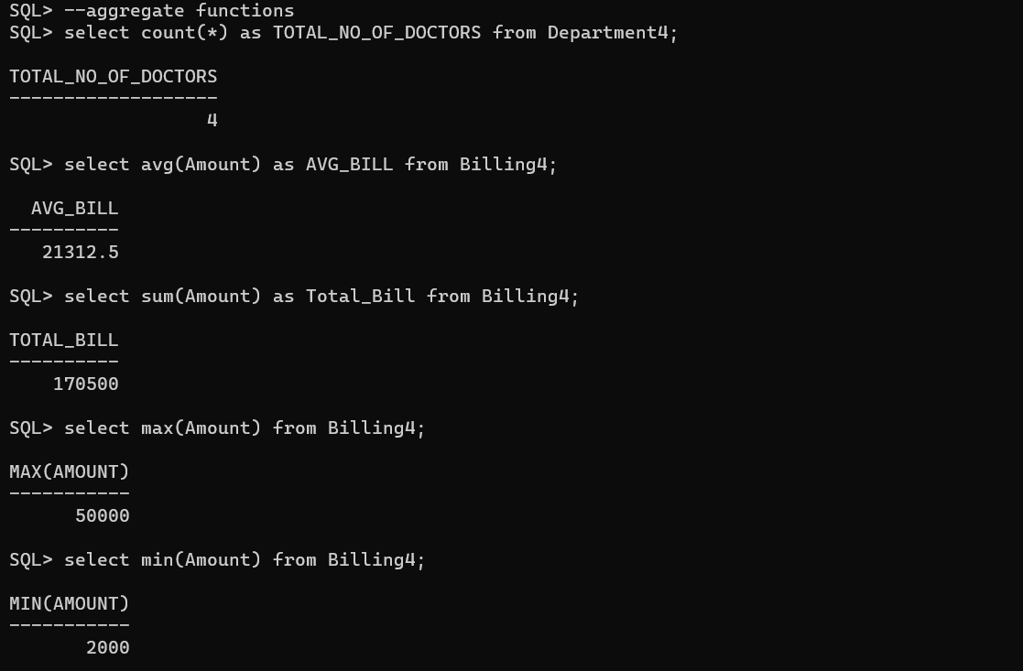
--aggregate functions
select count(*) as TOTAL_NO_OF_DOCTORS from Department4;
select avg(Amount) as AVG_BILL from Billing4;
select sum(Amount) as Total_Bill from Billing4;
select max(Amount) from Billing4;
select min(Amount) from Billing4;

Slide 8
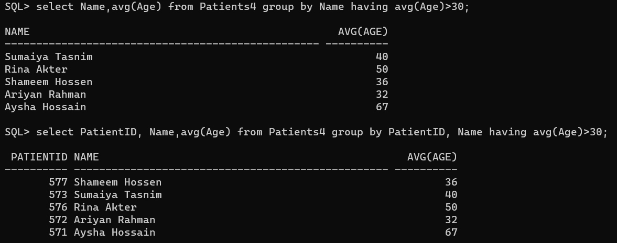
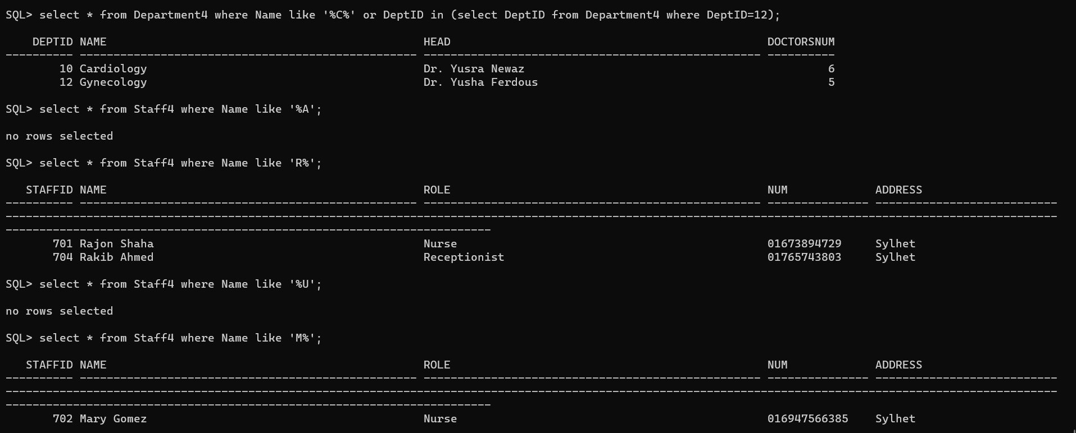
--Group by and having
select Name, avg(Age) from Patients4 group by Name having avg(Age)>30;
select PatientID, Name, avg(Age) from Patients4 group by PatientID, Name having avg(Age)>30;
--string operation
select * from Staff4 where Name like 'R%';
select * from Staff4 where Name like '%a';

Slide 9
THANK YOU

